Slide 1
WNM 617
jQuery Mobile Theming and CSS, jQuery Mobile Icons, Mobile First Design, Google Maps

Slide 2
jQuery Mobile Theming and CSS
Theming System, Theme Roller, CSS

Slide 3
jQuery Mobile Theming
jQuery Mobile Consists of a theming system that is entirely built with something we already know, CSS
A jQuery Mobile Theme consists of swatches.
A swatch consists of various CSS visual elements that we can apply to our jQuery Mobile Pages and Widgets
You can have up to 26 swatches that can be intermingled.
Each swatch is named by a letter, a-z

Slide 4
jQuery Mobile Theming
If we do not create or manipulate swatches jQuery uses the default a, b, and c swatches which we have seen so far
Why uses swatches? This allows us to keep the visual styles like color separate from structural styles like padding and margin. In other words swatches are only for items like colors and textures
How do we use a swatch on an element in a jQuery Mobile page? Simple add to an element
data-theme=“swatch letter”
Eg. data-theme=“b”

Slide 5
Theme Roller
So what if we want to create new themes? We use jQuery Themeroller!
https://themeroller.jquerymobile.com/
Once you have created new swatches click the download button
Name the theme
Check out the snippet of code that will need to go into your HTML file
Download the theme zip file and place in your project
Apply the swatches as needed with the data-theme attribute

Slide 6
jQuery Mobile CSS
Although it is possible editing a swatch by hand is not recommended. Use ThemeRoller instead.
There are many other CSS classes you can use with jQuery Mobile. Please see the PDF

Slide 7
jQuery Mobile Icons
As we have seen in the PDF you can change or use icons simply by using the correct CSS class
I want to use custom icons! Ok you can do that but first lets look at the requirements
Icons must have an SVG and PNG version. jQuery uses the SVG version for maximum compatibility with screens. The PNG is used for fallback
Icons are displayed using the :after pseudo element in CSS. To create a custom icon just target this.
DEMO

Slide 8
Mobile First Design
What is Mobile First Design?
It’s a buzz word that has had its day but the concepts are still in use

Slide 9
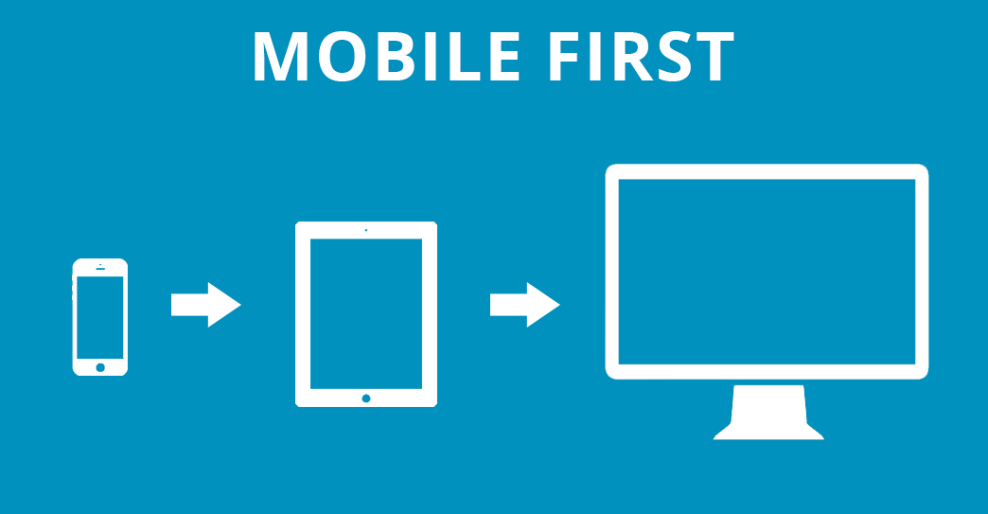
Mobile First Design

Slide 10
Benefits
Mobile First
Allows us to ADD functionality, content, images instead of removing it
Reinforces the mobile user experience
Content is King once again

Slide 11
Graceful Degradation vs Progressive Enhancement
Again some buzz words but still useful
In Graceful Degradation a website gradually scales back and removes functionality and content as it is displayed on smaller devices
With Progressive Enhancement is the opposite of Graceful Degradation. Designers start at the lowest common denominator and add features and content as the device gets larger

Slide 12
Google Maps with jQuery Mobile – Part 1
Step 1 – Include the required file links in your css
Step 2 – Create a div where the map will be inserted and displayed
Step 3 – Create the JavaScript that will
Build the map on the pageinit event
Add Geo Location if required for the map
Add Markers if required for the map
Next Week custom markers and styling maps

